Slide 1




B.Tech ECE Project-II (BECE498J) Review
Augmented Reality-Based Water Level Monitoring System
Team Members
GHitesh - 21BEC2087
Boga Vivek- 21BEC2159
Dhanush-21BEC2344
Faculty Guide:
Dr.ROHITH MATHUR,
Assistant Professor Sr. Grade 1,
School of Electronics Engineering,
Vellore Institute of Technology.

Slide 2


CONTENT
Software Tools and Hardware Tools
01
Introduction
07
02
Literature Review
08
Results analysis
03
Problem Formulation
09
Conclusion
04
RELEVANCE TO SDG
10
Contribution of individual Team members
05
Proposed System/Architecture
10
Impact of the project on society and environment
11
06
Analytical - Theoretical Description
12
11
References.

Slide 3

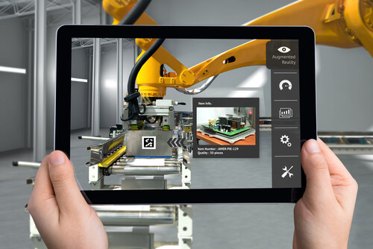
Introduction
Traditional monitoring methods rely on physical gauges or digital sensors, but they often lack real-time visualization and accessibility.
Augmented Reality (AR) enhances water level monitoring by overlaying real-time sensor data onto the physical environment, providing an interactive and intuitive representation.
Objective:
To design and implement a real-time water level monitoring system using IoT integrated with AR-based 3D visualization enhanced spatial data representation.

Slide 4
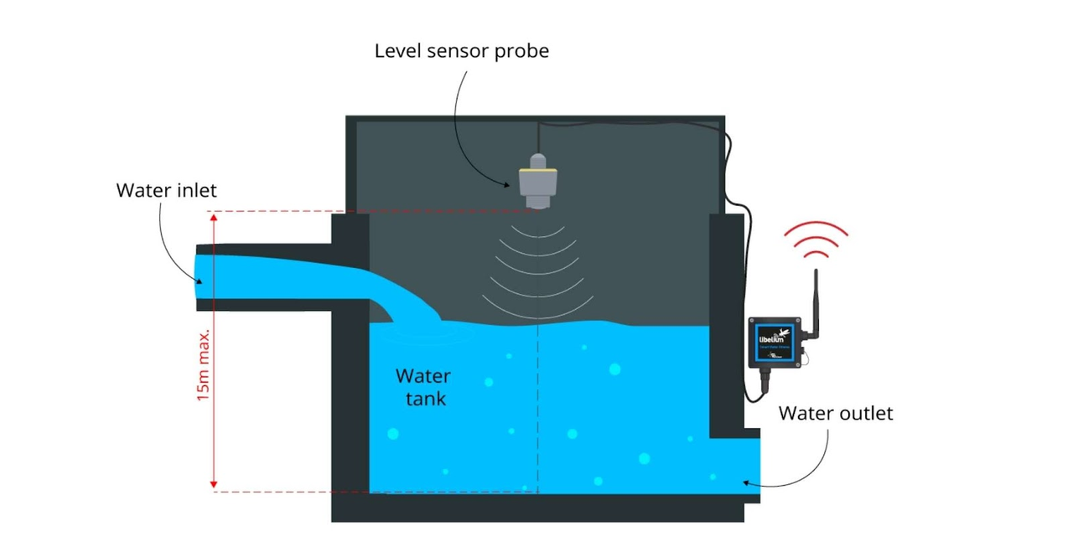

Literature Review
Traditional Water Level Monitoring Methods
Manual Gauges & Float Sensors – Require physical inspection and prone to human error.
Ultrasonic & Radar Sensors – Provide accurate measurements but lack interactive visualization.
IoT-Based Monitoring – Uses cloud-connected sensors for real-time updates but lacks user-friendly representation.
Augmented Reality (AR) in Environmental Monitoring
AR for Water Quality Monitoring – Used for real-time data representation.
Integration with IoT – Enhances real-time decision-making.
User Experience Benefits – AR makes complex data more accessible.

Slide 5


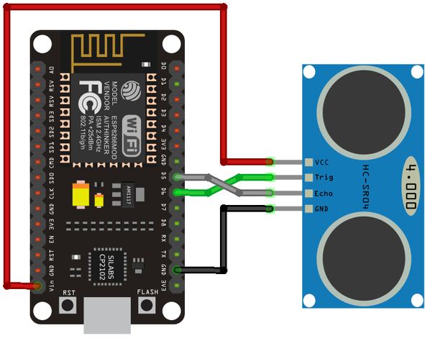
IoT in Water Monitoring
1. Smart Water Monitoring with IoT
Various researchers have developed low-cost IoT systems using sensors like ultrasonic and capacitive probes for real-time water level detection. These systems typically integrate microcontrollers like Arduino or ESP8266 and use wireless modules to transmit data efficiently.
2. Wireless Communication in Field Conditions
Studies show that wireless transmission over moderate distances (50–100 meters) using low-power modules is highly reliable for remote monitoring. Sensor nodes are usually battery-powered and communicate with a central hub or cloud service.
3. Cloud Integration for Data Logging
Projects have highlighted the role of platforms like Firebase or Thingspeak in storing, visualizing, and analyzing collected data in real-time, improving decision-making for users like farmers and municipal workers.

Slide 6
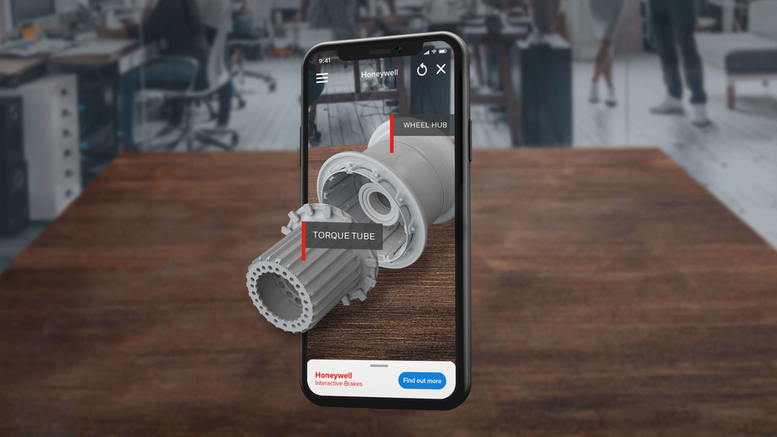
Augmented Reality (AR) in
Monitoring Systems
1. AR for Data Visualization
Recent research has explored using AR for visualizing IoT data in a more intuitive way. AR interfaces allow users to see live water levels or system alerts by scanning a marker or QR code, enhancing user interaction.
2. AR + IoT Synergy in Agriculture
Studies combining AR with smart agriculture systems show improvements in operational efficiency. AR helps visualize invisible data (like water inside tanks) and offers real-time context, making complex information accessible and engaging.
3. User-Friendly Interfaces
Tools like Unity and Vuforia are commonly used to build AR apps that run on smartphones. These tools enable smooth overlay of 3D models and sensor data, reducing the learning curve for end-users and making the system suitable for non-technical users.

Slide 7
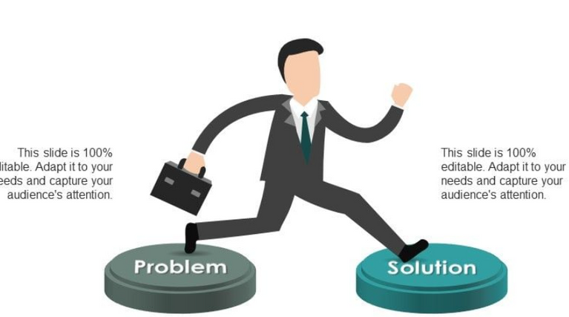
Problem Formulation
Traditional water level monitoring methods are often manual, time-consuming, and prone to human error. This creates challenges in efficient water management, especially in remote or agricultural areas where consistent monitoring is crucial. Moreover, current digital monitoring systems often lack interactive or intuitive visualizations, making it difficult for users to interpret real-time data effectively.
To address these gaps, this project formulates a solution that:
Uses IoT sensors for accurate and real-time water level detection.
Employs wireless transmission (ESP8266) for remote access.
Integrates Augmented Reality (Unity + Vuforia) to visualize water levels in an
intuitive and interactive 3D format.
Provides a scalable, user-friendly, and low-cost alternative to traditional systems.

Slide 8


Relevance to Sustainable Development
Goals (SDGs)
This project directly supports several United Nations SDGs by promoting efficient, sustainable, and smart water management:
SDG 6 – Clean Water and Sanitation
Enables real-time water level monitoring to reduce wastage and improve access to clean water.
SDG 9 – Industry, Innovation, and Infrastructure
Utilizes IoT and AR technologies to build intelligent infrastructure for environmental monitoring.
SDG 11 – Sustainable Cities and Communities
Enhances resource monitoring systems for smart urban and rural planning.
SDG 13 – Climate Action
Supports water conservation and climate resilience by enabling early detection
of abnormal water levels.

Slide 9
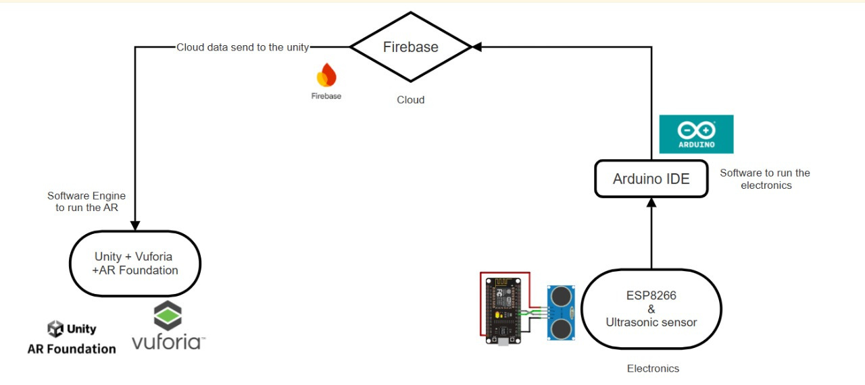
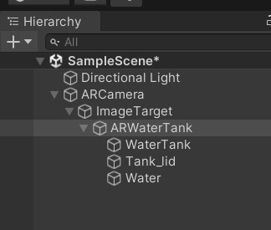
Proposed System/Architecture
Flow chart
Heirarchy in Unity

Slide 10


The system architecture is designed to enable seamless sensing, wireless data transmission, and intuitive 3D visualization through AR:
Sensor Node (Transmitter):
Ultrasonic sensor detects real-time water levels.
ESP8266 microcontroller processes sensor data.
Central Node (Receiver):
Another ESP8266 module receives and forwards the data.
Firebase Cloud is used for data storage and access.
AR Visualization Module:
Unity engine with Vuforia SDK fetches live data from Firebase.
Water levels are displayed in an interactive 3D tank model using mobile AR.

Slide 11
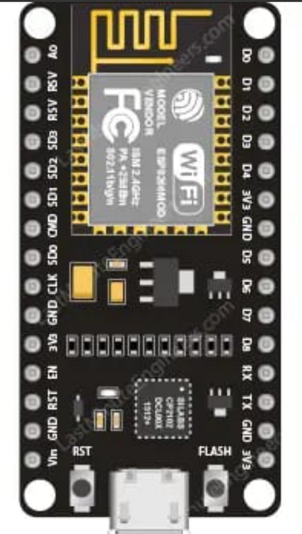
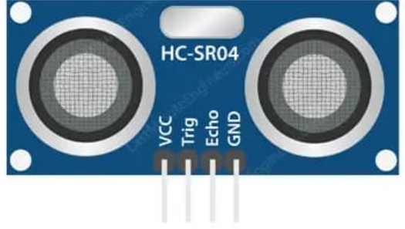
Analytical and Theorical Description
ESP8266 NodeMCU Pinout Description
The ESP8266 NodeMCU is a popular microcontroller for IoT applications. It operates at 3.3V logic level, so care must be taken when connecting 5V sensors.
Vin → Used for power input (5V).
3.3V → Supplies power to 3.3V sensors.
GND → Ground connection for all components.
D0 (GPIO16) → Can be used for deep sleep wake-up functions.
D1 (GPIO5) & D2 (GPIO4) → Typically used for I2C communication (SCL & SDA).
D3 (GPIO0) & D4 (GPIO2) → General-purpose digital I/O, D4 is also connected to the built-in LED.
D5 (GPIO14) & D6 (GPIO12) → Suitable for ultrasonic sensor connections (TRIG & ECHO).
D7 (GPIO13) & D8 (GPIO15) → General-purpose I/O pins.
A0 → Analog input pin (0-3.3V), used for sensors like capacitive water level sensors
Ultrasonic Sensor (HC-SR04) Pin Configuration
VCC → Connect to 5V (ESP8266 Vin).
GND → Connect to Ground (ESP8266 GND).
TRIG → Connect to any GPIO pin (e.g., D5) to trigger ultrasonic pulses.
ECHO → Connect to any GPIO pin (e.g., D6) to receive the reflected pulse (use a voltage divider as ESP8266 operates at 3.3V).

Slide 12
Augmented Reality (AR)
Augmented Reality (AR) is a technology that overlays digital information onto the real world using a camera-enabled device such as a smartphone or AR headset.
Unlike Virtual Reality (VR), which creates a completely virtual environment, AR enhances real-world objects by adding interactive visuals and data.
AR operates based on three core components:
🔹 Hardware – Devices such as smartphones, AR glasses, or tablets that capture real-world visuals and overlay digital content.
🔹 Software – AR applications process real-time data and integrate virtual elements with real-world objects.
🔹 Algorithms & Sensors – AR systems use cameras, GPS, accelerometers, gyroscopes, and depth sensors to detect real-world objects and place virtual elements accurately.
The process follows these steps:
Tracking & Recognition – The AR system scans the physical environment using the camera and identifies objects or markers (QR codes, predefined surfaces, or real-world objects).

Slide 13
Data Processing – The AR software computes spatial positioning and aligns virtual content with the real-world view.
Rendering & Display – The digital overlay (3D models, animations, data visualizations, etc.) is projected onto the user’s screen in real-time.
Types of AR Technologies
1️⃣ Marker-Based AR – Uses predefined markers (QR codes, printed images, etc.) to trigger AR content when scanned.
2️⃣ Markerless AR – Uses device sensors (GPS, accelerometer) to place digital content dynamically without predefined markers.
3️⃣ Projection-Based AR – Projects digital images onto real-world surfaces, allowing users to interact with them.
4️⃣ Superimposition AR – Overlays virtual objects on top of real-world objects, partially or fully replacing them.

Slide 14

Augmented Reality (AR) in Water Level Monitoring
AR helps visualize real-time water levels in a more intuitive and interactive way.
Users can point their smartphones at a water tank, reservoir, or river, and AR will display:
✅ Current water level status (e.g., Safe, Moderate, Critical).
✅ Real-time sensor readings mapped onto the physical tank.
✅ Historical trends and forecasts for predictive water management.
✅ Alerts and notifications when water levels exceed safe limits.
Benefits of AR in Water Level Monitoring
🔹 Improved Decision-Making – Visual representation makes it easier to understand water levels at a glance.
🔹 Enhanced User Engagement – AR makes monitoring more interactive and user-friendly.
🔹 Real-Time Data Access – Users can instantly see changes without needing manual inspections.
🔹 Remote Monitoring – Authorities and individuals can track water levels from anywhere using their mobile devices.
🔹 Preventive Measures – Early alerts through AR interfaces help prevent water shortages or overflow issues.

Slide 15




Hardware and Software tools and Simulation
Fire Base
Node MCU
Arduino Ide
Vuforia engine
Ultra sonic sensor
Unity AR

Slide 16


Result Analysis
System Performance and Data Accuracy
1. Sensor Accuracy & Readings:
The ultrasonic sensor (HC-SR04) accurately detected water levels with an average error margin of ±1.5 cm.
Consistent readings were observed under stable environmental conditions.
2. Data Transmission Performance :
Wireless communication using the nRF24L01 module (with PA+LNA) successfully transmitted data up to 70 meters in an open field.
Less than 2% packet loss was recorded after multiple test cycles.
3. Real-Time Data Monitoring :
Data was pushed to Firebase with minimal latency (approximately 1.2 seconds delay on average).
The system maintained synchronization between sensor data, cloud database, and the AR interface without disruptions.
4. Stability & Power Consumption :
The ESP8266 microcontroller remained stable during extended use (tested over 6 hours continuously).
Low-power design ensured optimal energy usage—ideal for solar-powered or battery-backed rural setups.

Slide 17
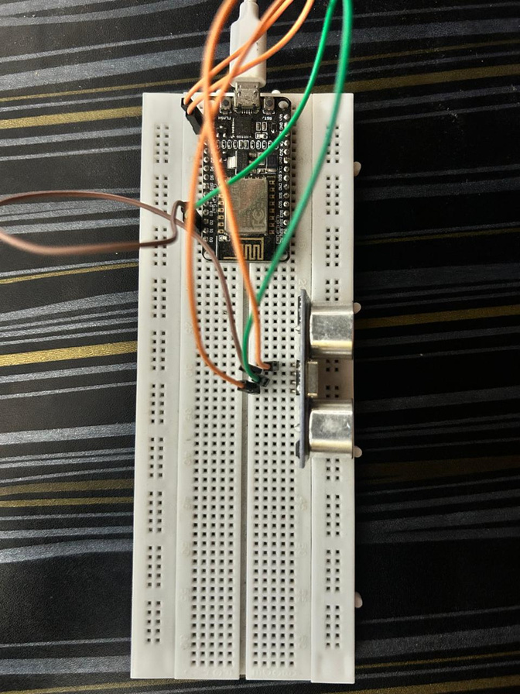
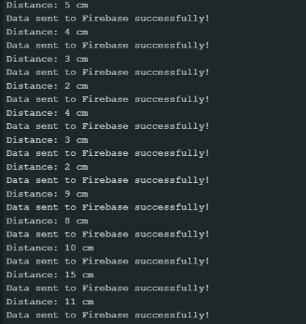
Result Analysis
Circuit
Sensor Readingss

Slide 18
Result Analysis
Augmented Reality Response & User Interface
1. Unity + Vuforia Visualization
The Vuforia-based marker detection in Unity successfully rendered the water tank model in AR within 1–2 seconds.
Water levels updated in real time, reflecting Firebase data changes instantly.
2. Firebase Integration
The database efficiently handled continuous data inputs and served them to the AR interface without delays.
Data consistency and reliability were maintained even under rapid updates.
3. User Experience
The AR application offered an intuitive and immersive experience for visualizing tank levels.
Potential users (e.g., farmers or facility managers) could easily identify water status without opening physical tanks.
4. Observations from Field Testing
The system worked reliably under various lighting conditions.
Minor interference from ambient noise and heat was observed but did not significantly affect sensor readings.

Slide 19


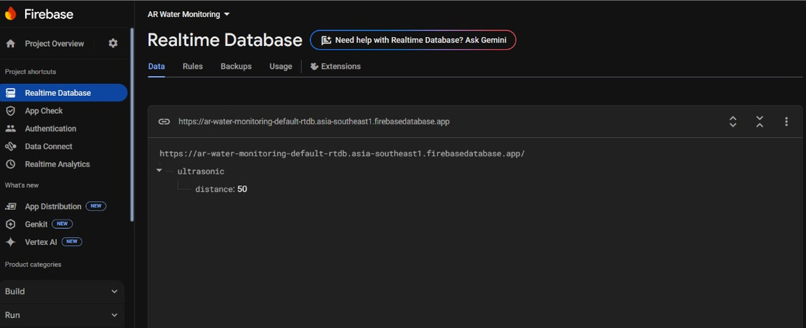
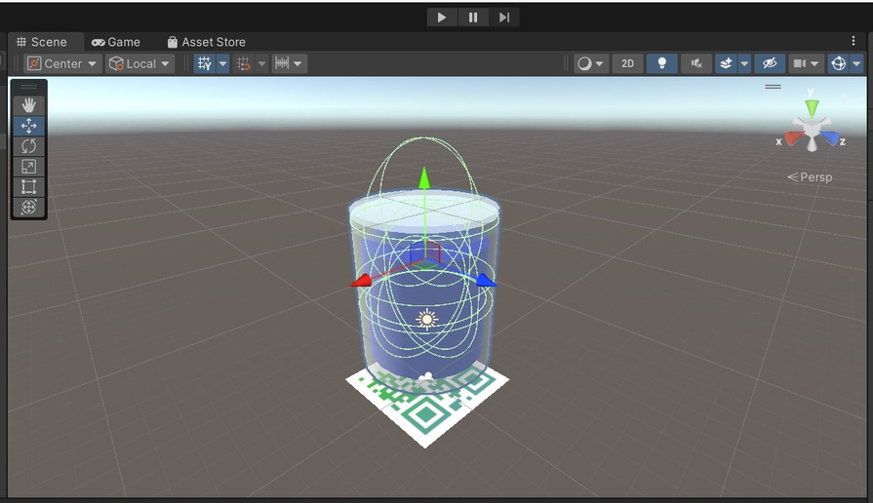
Result Analysis
Augmented Reality Response & User Interface
UNITY application
Image Target
Fire base data readings
Object Iin UNITY

Slide 20
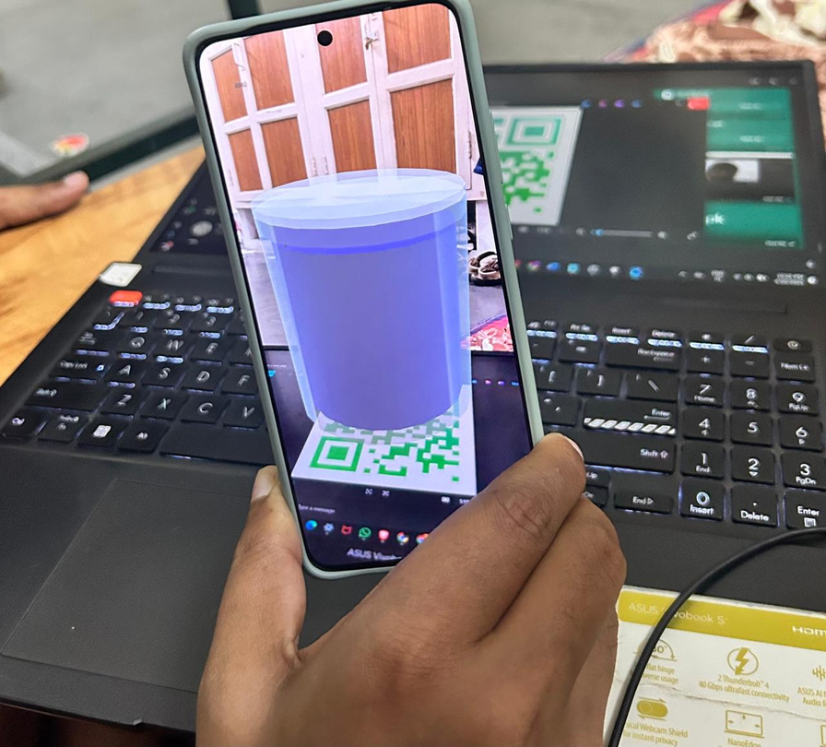
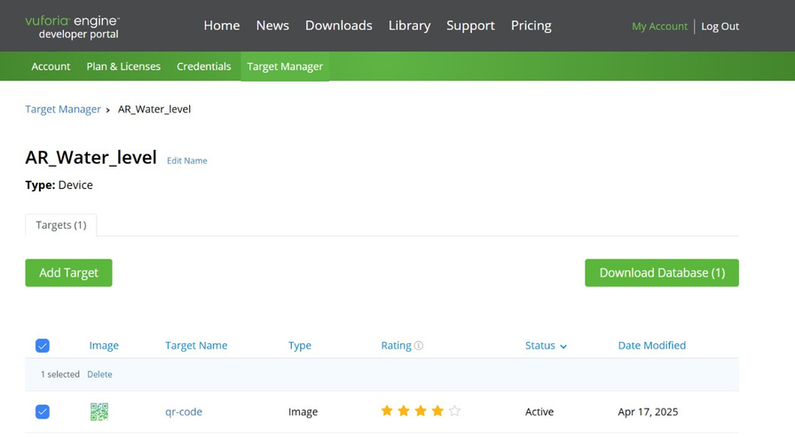
Result Analysis
Augmented Reality Response & User Interface
Vuforia database
Water tank in Application

Slide 21
Conclusion
The developed system successfully integrates ultrasonic sensing, ESP8266 microcontroller, and cloud-based data visualization through Firebase and AR using Unity with Vuforia.
It delivers accurate real-time monitoring of water levels with a user-friendly AR interface, enhancing accessibility and remote decision-making.
Field testing confirmed the system’s reliability, low power consumption, and data transmission efficiency over long distances.
This cost-effective and scalable prototype offers significant potential for smart resource management in agriculture, industry, and rural infrastructure.

Slide 22

Individual Contribution
Vivek | A key contributor, focused on coding, developing the hardware and managing project execution. His leadership ensured effective completion of tasks, focusing on technical development ensuring successful project completion.
Hitesh | Implementing solutions and refining the system.He prepared the final Report and power point presentation, ensuring clear communication of the project's findings to the audience.
Dhanush | Helped the team to complete the project in time and made the help to complete the presentation

Slide 23

Impact of the project on society and environment
1. Water Conservation
The system promotes responsible water usage by enabling real-time monitoring, helping reduce wastage in agriculture, households, and industrial setups.
2. Empowering Rural Communities
With its affordable and easy-to-use design, the solution empowers farmers and rural stakeholders to make informed decisions without relying on costly infrastructure.
3. Environmental Sustainability
By minimizing overflows and optimizing water distribution, the system supports sustainable practices that help protect freshwater resources and ecosystems.
4. Technological Awareness
Integrating IoT and AR technologies into daily water management fosters innovation and boosts tech adoption in under-resourced regions.

Slide 24
References
G. Jha, P. Singh and L. Sharma, "Recent advancements of augmented real-ity in real time applications", International Journal of Recent Technology and Engineering, 2019.
Difference between Marker Based and Marker less Augmented Reality, [online] Available: https://stackoverflow.com/questions/27229465/difference-between-marker-based-and-markerless-augmented-reality.
Gitanjali Rahul Shinde et al., "Augmented Reality and IoT", Internet of Things Integrated Augmented Reality, pp. 55-71, 2021.
Chaves-Diéguez David et al., "Providing IoT services in smart cities through dynamic augmented reality markers", Sensors, vol. 15.7, pp. 16083-16104, 2015.
V. V. Daigavane and M. A. Gaikwad, "Water Quality Monitoring system based on IOT", vol. 10, no. 5, pp. 1107-1116, 2017.

Slide 25

Thank You
2025

